Slide 1

Lesson 2: Turning up the Style and Data!
David Intersimone “David I” Vice President of Developer Relations and Chief Evangelist
davidi@embarcadero.com

Slide 2
Mobile App Development
Lesson 1 – Hello World! My First Multi-Device App
Lesson 2 – Turning up the Style and Data!
Lesson 3 – Accessing Local Storage
Lesson 4 – Building Multi-tier, Multi-device Apps
Lesson 5 – Connecting Mobile and Desktop using Tethering
Lesson 6 – Accessing REST and BaaS Cloud Services
Replay links and lesson slides will appear on my blog
http://blogs.embarcadero.com/davidi/

Slide 3
Lesson 2 Agenda
Styles
TListBox and TListView
LiveBindings
PrototypeBindSource
Samples and Snippets
Continue development of the mobile business app
Review, Homework and Next Time
Q&A

Slide 4
Styles
FireMonkey controls are arrangements of a tree composed of subcontrols, primitive shapes and brushes, decorated with effects and defined as styles.
Styles are stored in a ”style book” – TStyleBook component. Apps have a default “style book” built in. Set a form’s StyleBook property to use a different style.
Individual elements of a style are internally called resources; because that term has several other meanings, the term style-resource is used for clarity.
Styles provide a great deal of customization without subclassing.
The StyleName property is the name by which a style or style subcomponent is known to others and can be found.
A control's StyleLookup property is set to the name of the desired style-resource to adopt that style for the specific control. When StyleLookUp is empty, the default style is used.
The Bitmap Style Designer enables you to Create, Edit and Test FireMonkey styles

Slide 5
Style Resolutions and Platforms
The various target platforms (Windows, Mac OS X, iOS, and Android) can support different resolutions at run time:
The Mac OS X and iOS platforms support the Retina display (2880×1800 or 5.2 megapixels), which doubles the standard resolution. So Mac and iOS support two different resolutions: 1x, 2x.
The Android platform supports four different resolutions: 1x, 1.5x, 2x, 3x.
Windows supports only standard resolution.
iOS and Android style files are found in the
C:\Users\Public\Documents\Embarcadero\Studio\14.0\Styles\iOS
C:\Users\Public\Documents\Embarcadero\Studio\14.0\Styles\Android

Slide 6
Changing a Control’s Style in a Mobile App
Choose File > New > FireMonkey Mobile Application and choose any mobile template.
Place a control on your form (for example, FMX.StdCtrls.TButton):
In the Form Designer, select the TButton on your form.
In the Object Inspector, click the Down Arrow in the StyleLookup property.
In the StyleLookUp popup menu, you can see the different designs for the button, as shown in the illustration.
Apply a style by selecting the design you want. For example, you might select the Info button
Also, the style of a control can be set by changing the style of the entire form.

Slide 7
Working with Styles at runtime
You can load a Style at runtime from a file
TStyleManager.SetStyleFromFile(<style filename>);
TStyleManager::SetStyleFromFile(<style filename>);
Do not place multiple lines calling SetStyleFromFile in a project, because you can have only one active style in the style manager.
You can call SetStyleFromFile either in the project source code (before calling Application.Initialize) or in the initialization section of one of the form units:
If you call SetStyleFromFile in a form, the style is reapplied.
If you call SetStyleFromFile before the form is created, the custom style fully replaces the platform style.
You can load a Style at runtime from a resource in your project
Add your custom styles to the project resources: Select Project > Resources and Images.
Load your custom Android style and set the identifer to Android<StyleName>.
Load your custom iOS style and set the identifier to iOS<StyleName>.
Style := TStyleManager.LoadFromResource(HInstance, 'AndroidDark', RT_RCDATA);
TStyleManager.SetStyle(Style);
style = TStyleManager::LoadFromResource((unsigned int)HInstance, L"AndroidDark", RT_RCDATA);
TStyleManager::SetStyle(style);
http://docwiki.appmethod.com/appmethod/1.14/topics/en/Working_with_Native_and_Custom_FireMonkey_Styles

Slide 8
Looking at sample Controls with Styles
Mobile Samples\User Interface\Controls
ToolBars
ToolButtons
Tabs
ListBoxes
Controls
Editors

Slide 9
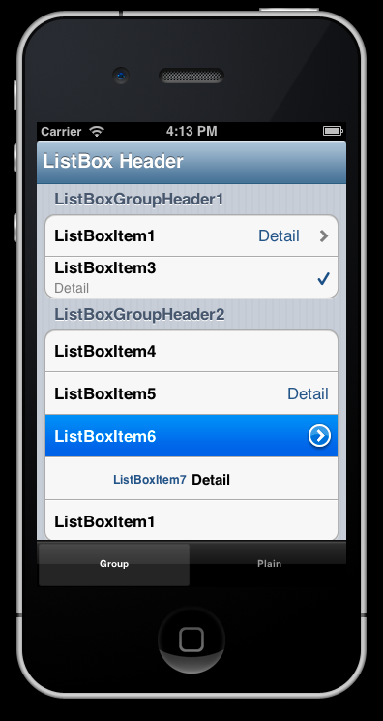
TListBox
TListBox displays a set of items in a scrollable list.
TListBox can contain
TListBoxItem
TListBoxHeader
TSearchBox
TListBoxGroupHeader, TListBoxGroupFooter
Some TListBox properties
MultiSelect property - set the list to accept single-item or multi-item selection
Each item’s ItemData can have an Accessory, Bitmap, Detail, Text
Set different backgrounds for consecutive list items by using the AlternatingRowBackground.
Note: TListBox performance can be slow on mobile. Use TListView if you want to develop more complex applications, especially apps with large databases.

Slide 10
TListView
TListView displays a collection of items in a list that is optimized for LiveBindings and for fast and smooth scrolling.
The items in the list view can have one or more of the following appearance features:
A caption or detail text (for example, using the Item.Text bindable member of TListView)
An associated image (for example, using the Item.Bitmap bindable member of TListView)
An accessory icon (for example, using the ItemEditAppearance property in the Object Inspector)
A graphic or a text button attached (for example, using the Item.ButtonText bindable member of TListView)
Enabling the Swipe-to-Delete Feature on TListView Items
When the Swipe-to-Delete feature is enabled, the end user can swipe an item in a list view, and a Delete button temporarily appears on the item.
The user can then click the Delete button to delete the item from the list view, or release the swipe to retain the item in the list view. This feature works on mobile (that is, iOS and Android), and, when touch input is enabled, on desktop apps as well (Mac OS X and Windows).
To set the swipe-to-delete feature on TListView items, set the CanSwipeDelete property to True.

Slide 11
LiveBindings and the LiveBindings Designer
LiveBindings is a data-binding feature supported by the FireMonkey framework
The primary way to create bindings is using the LiveBindings Designer. The Designer can only create QuickBindings components.
There is a second way to create such bindings, using the LiveBindings Wizard. It also only creates QuickBinding components.
The LiveBindings Designer uses QuickBindings to create this type of bindings (which is also reflected in the wizard):
Link a control such as TEdit to a field in a data source
Link a control such as a TGrid to a data source
Link a control such as TEdit to a component property (such a TLabel.Text)
Link a component property to a field in a data source
You can save LiveBindings Diagram as an Image

Slide 12
LiveBindings Wizard
Tools | Options | LiveBindings – to display the LiveBindings Wizard in the context menu
The context-sensitive LiveBindings Wizard is invokable through the right-click menu on a form or on any control on that form. Depending on your selection of binding tasks in the first wizard page, one or more of the wizard pages described below are accessible for you in the LiveBindings Wizard.
Binding Task Page
Data Source Page
Field Page
Options Page
Component Property Page
Control Page

Slide 13
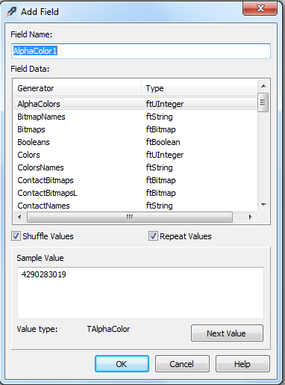
PrototypeBindSource
When designing applications that make use of the LiveBindings framework, you can use aTPrototypeBindSource component readily available in the Tool Palette to generate sample data for your bindings.
Properties
AutoActivate
AutoEdit
AutoPost
Right-Mouse click context menu
Add fields and their types
Add Navigator

Slide 14
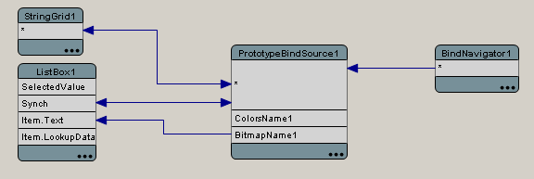
Synchronizing Data through LiveBindings
Synchronize data using the Synch and * properties of certain components within the LiveBindings Designer.
On a main form, drop these components:
TPrototypeBindSource -- will provide the sample data.
TBindNavigator -- will provide navigation functionality for the sample data.
TListBox -- will display some information (for instance names of alpha colors).
TStringGrid -- will display all information about the sample data.
In the Object Inspector set the Options.goEditing property to True. This allows for editing of the items directly into the string grid.

Slide 15
ListBox, ListView & PrototypeBindSource Samples
Folders
C:\Users\Public\Documents\Embarcadero\Studio\14.0\Samples\CPP\Mobile Samples\User Interface
C:\Users\Public\Documents\Embarcadero\Studio\14.0\Samples\Object Pascal\Mobile Samples\User Interface
ListBox
Settings Project – SettingsDemo
ListView & PrototypeBindSource
ListViewCheckListProject
SimpleListView

Slide 16
Next Steps for our Business Mobile App
Add a PrototypeBindSource for Customer data
Add ListView to Customer tab item
Set “CanSwipeDelete” property
Bind PrototypeBindSource data to the ListView
Add a ListBox to the Settings tab item
Set StyleLookup = transparentlistboxstyle
Set GroupingKind = Grouped
Add a TListBoxGroupHeader – “Push Notifications”
Add ListBoxItem – “Order Shipped” with a TSwitch
Add ListBoxItem – “Parts Backordered” with a TSwitch

Slide 17
Lesson 2 Review
Customize your app using styles
Use TListBox and TListView for grouping data in your UI
Use LiveBindings to connect data to your UI controls
Use PrototypeBindSource to view the UI/Data until the database is ready
Continued work on the business mobile app

Slide 18
Resources
Styles - Docwiki
http://docwiki.appmethod.com/appmethod/1.14/topics/en/Customizing_FireMonkey_Applications_with_Styles
http://docwiki.appmethod.com/appmethod/1.14/topics/en/Applying_FireMonkey_Styles
http://docwiki.appmethod.com/appmethod/1.14/topics/en/FireMonkey_Style_Designer
http://docwiki.appmethod.com/appmethod/1.14/topics/en/Working_with_Native_and_Custom_FireMonkey_Styles
ListView and ListBox – Docwiki
http://docwiki.appmethod.com/appmethod/1.14/libraries/en/FMX.ListView.TListView
http://docwiki.appmethod.com/appmethod/1.14/libraries/en/FMX.ListView.TListViewItem
http://docwiki.appmethod.com/appmethod/1.14/libraries/en/FMX.ListBox.TListBox
http://docwiki.appmethod.com/appmethod/1.14/topics/en/Mobile_Tutorial:_Using_LiveBindings_to_Populate_a_ListView_(iOS_and_Android)
LiveBindings and PrototypeBindSource
http://docwiki.appmethod.com/appmethod/1.14/topics/en/LiveBindings_Designer
http://docwiki.appmethod.com/appmethod/1.14/topics/en/LiveBindings_Wizard
http://docwiki.appmethod.com/appmethod/1.14/topics/en/Creating_LiveBindings
Blogs
http://blogs.embarcadero.com/
Jim McKeeth - http://delphi.org/
Sarina Dupont - http://blogs.embarcadero.com/sarinadupont/
Note: http://docwiki.appmethod.com/appmethod/1.14/topics/en/... = http://docwiki.embarcadero.com/RADStudio/XE6/en/...

Slide 19
Homework & Next Time
Create your own apps using Styles, TListBox, TListView, LiveBindings and the PrototypeBindSource
Take a look at more mobile samples and snippets
Explore the Docwiki articles and tutorials listed on the Resources page
Continue work on the business mobile app
Lesson 3 – Accessing Local Storage
Local Storage
IniFiles
FireDAC database access components
FDMemTable – in memory dataset
Mobile local SQL databases SQLite, IBLite, IBToGo
Note: http://docwiki.appmethod.com/appmethod/1.14/topics/en/... = http://docwiki.embarcadero.com/RADStudio/XE6/en/...

Slide 20
Q&A

Slide 21
Thank You ☺
davidi@embarcadero.com

